Slide 1
A Long-Term Archival Pipeline for the Forschungsdatenplattform
omeka2dsp Moritz Mähr Moritz Twente

Slide 2
Stadt.Geschichte.Basel
Large-scale historical research project, initiated in 2011 by the Association for Basel History and carried out 2017–2026 at the University of Basel
More than 70 researchers studying the history of Basel from the earliest settlements to the present day
Funded with more than 9 million Swiss francs by the Canton of Basel-Stadt, the Lottery Fund, and private sponsors
Specialized Team for Research Data Management and Public History
Various research outputs (incl. books, papers, data stories, figures, and source code)

Slide 3
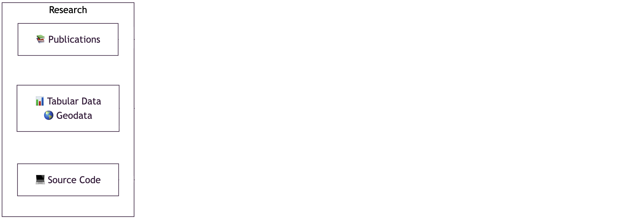
Research Data

Slide 4
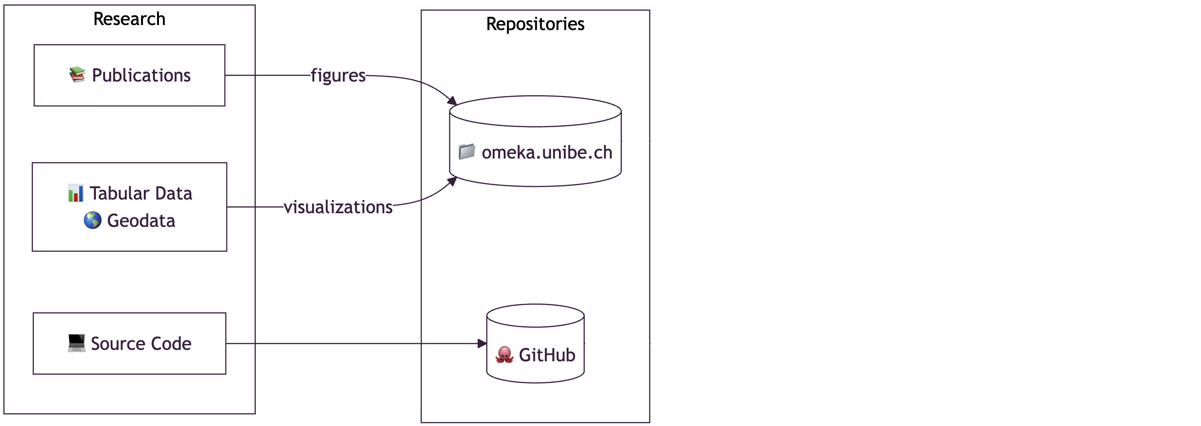
Collecting and Managing Research Data

Slide 5
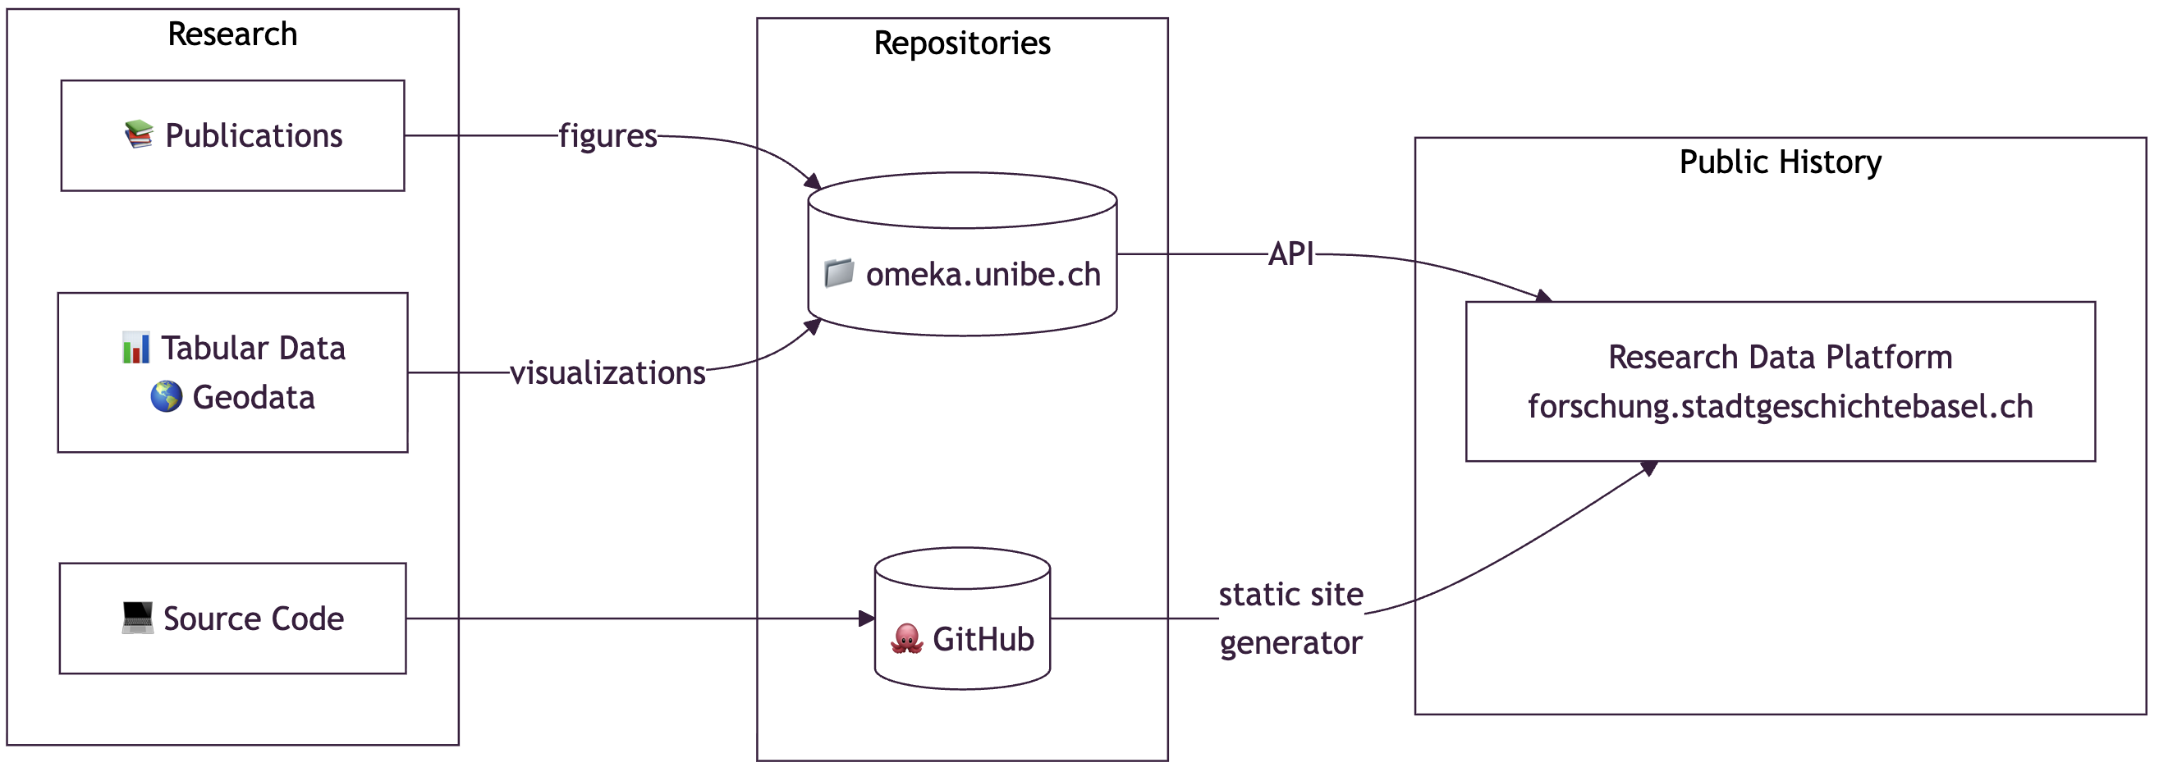
Public History with Research Data

Slide 6
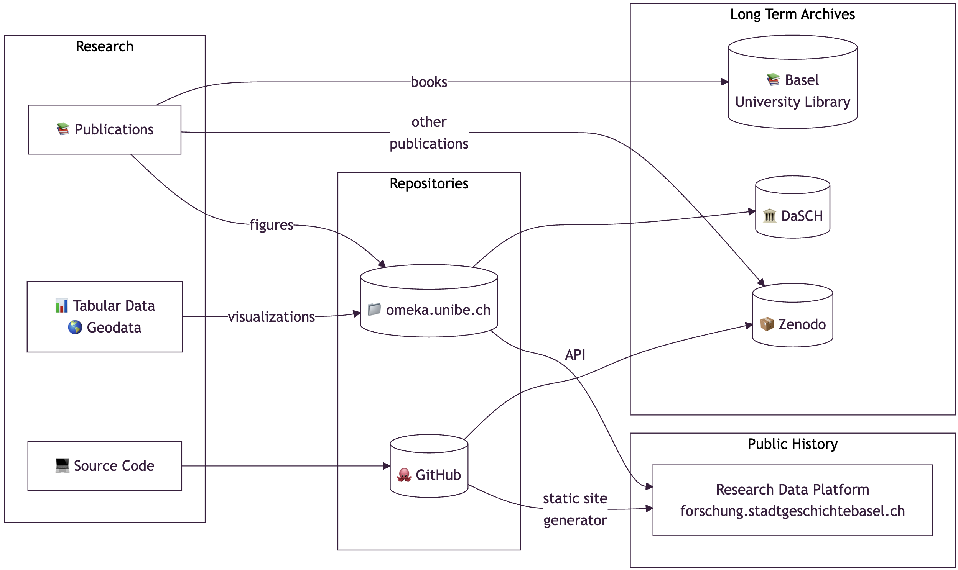
Archiving Research Data for the Long Run

Slide 7
Long-Term Preservation
Institutional sustainability: External dependencies (Omeka at UniBern) may not be permanently funded
FAIR principles: Research data must be Findable, Accessible, Interoperable, and Reusable with proper metadata
Citability: Researchers need persistent identifiers (PIDs) (stable URLs or DOIs) to reference historical materials
Scalability: Current minimal computing approach (GitHub Pages) cannot handle large files

Slide 8
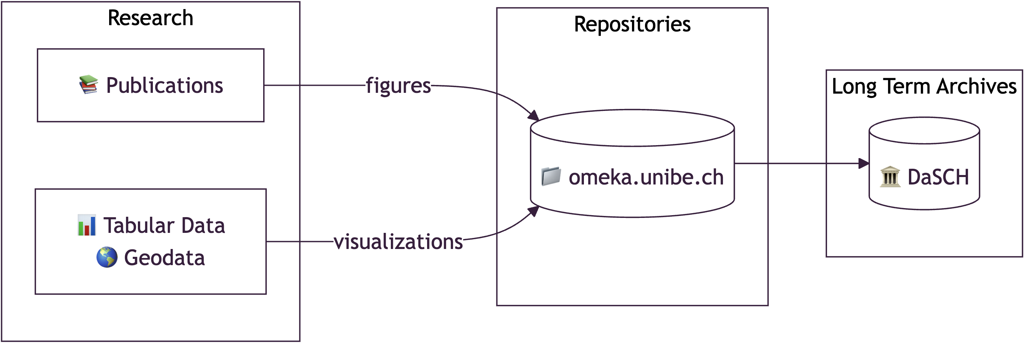
Where DaSCH Fits in: omeka2dsp

Slide 9
Challenges
Data model differences (Omeka vs DaSCH)
Metadata transformation and crosswalks
Automation of deposit and version control

Slide 10
Data Model Differences

Slide 11
Omeka

Slide 12
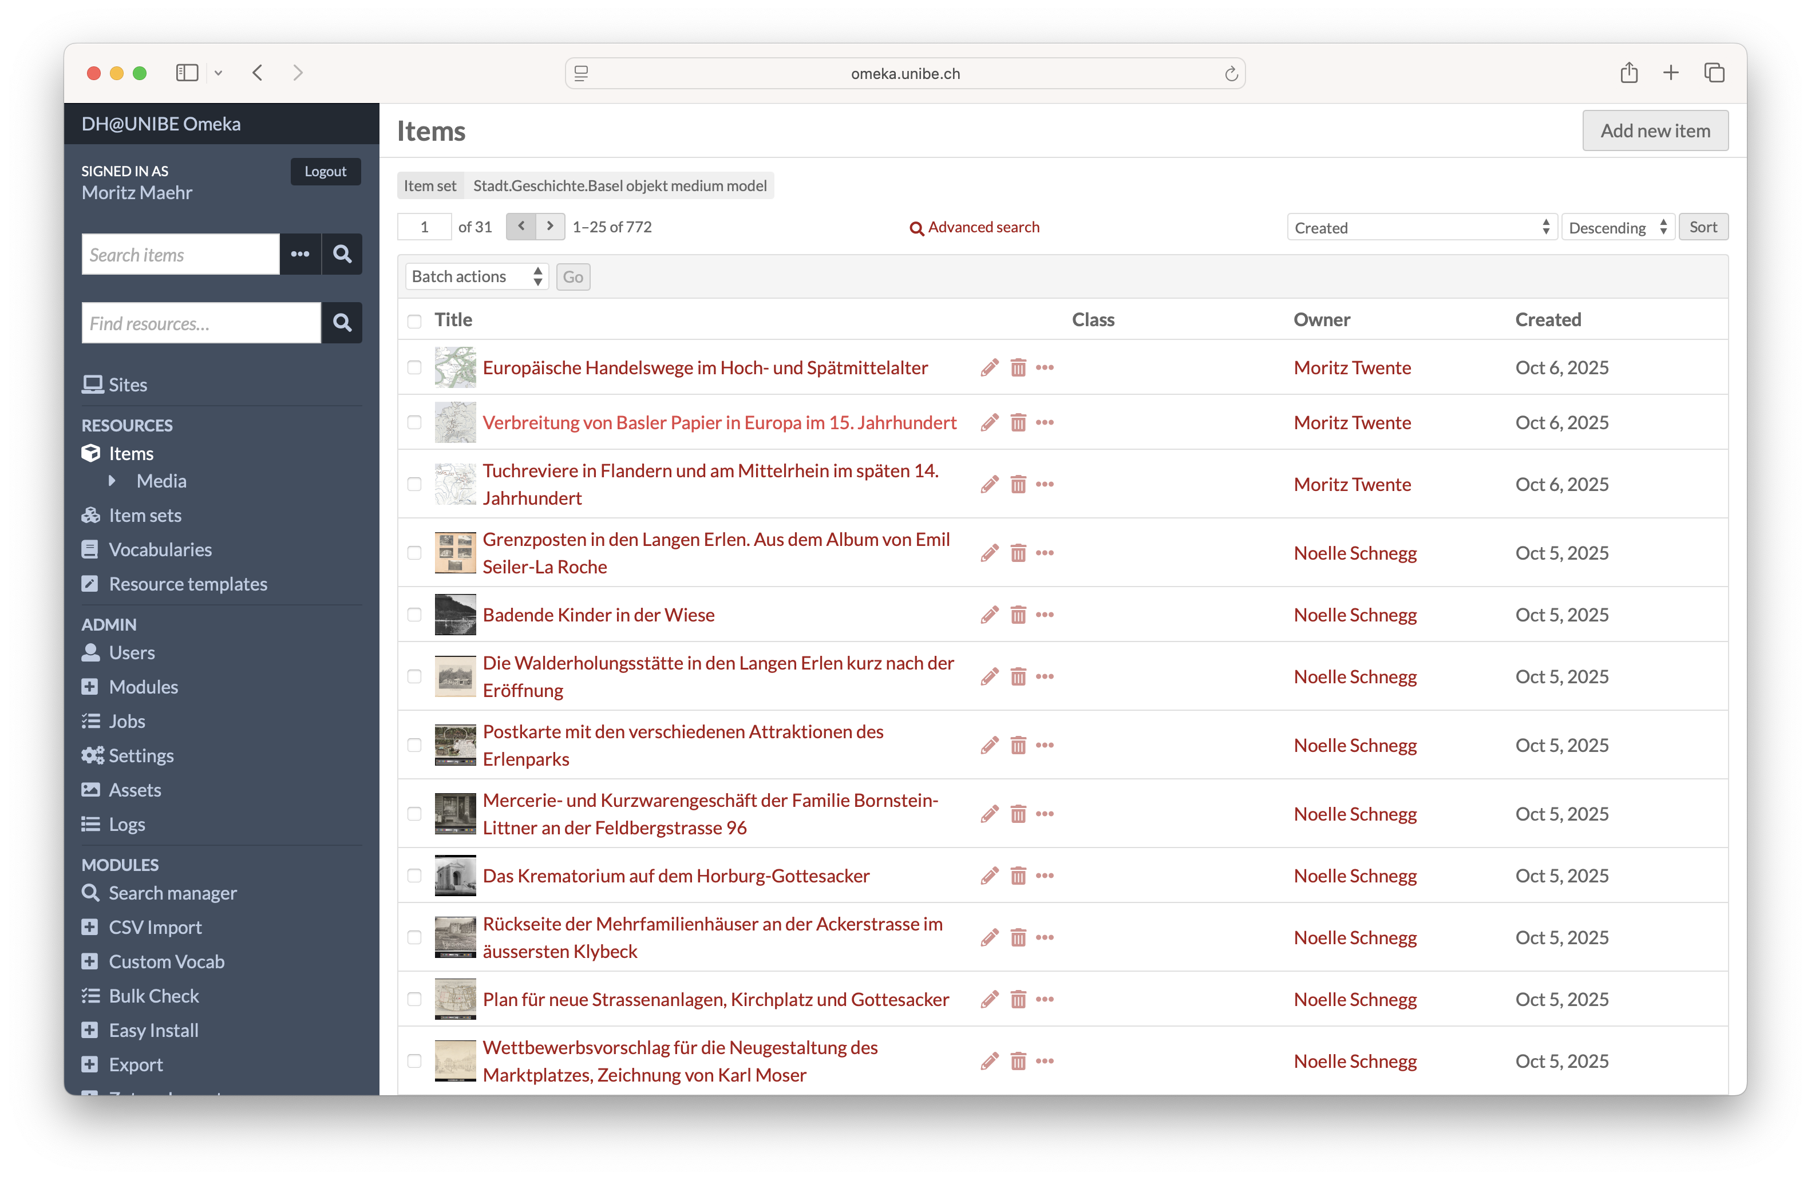

Slide 13
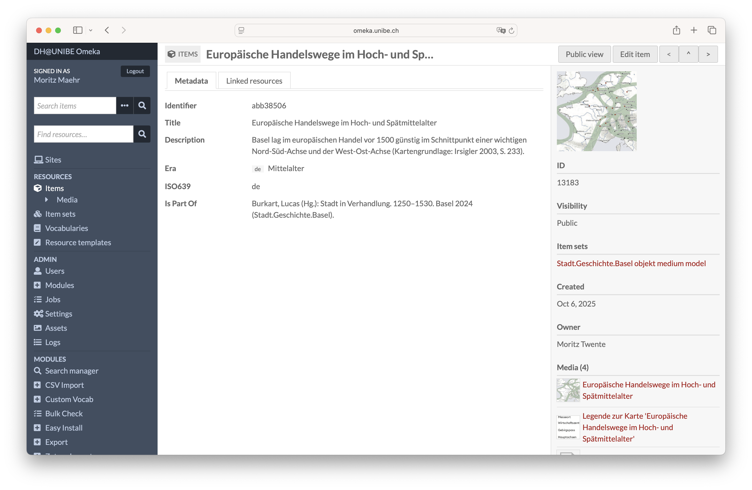

Slide 14
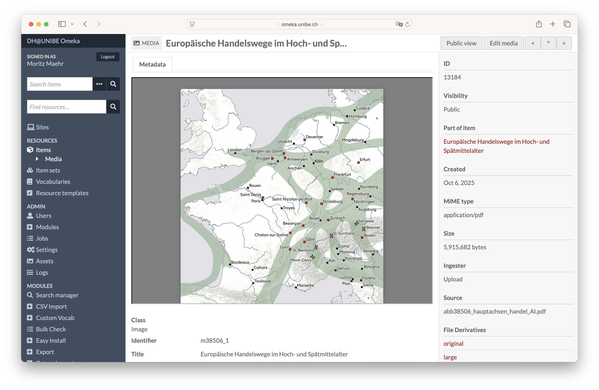

Slide 15
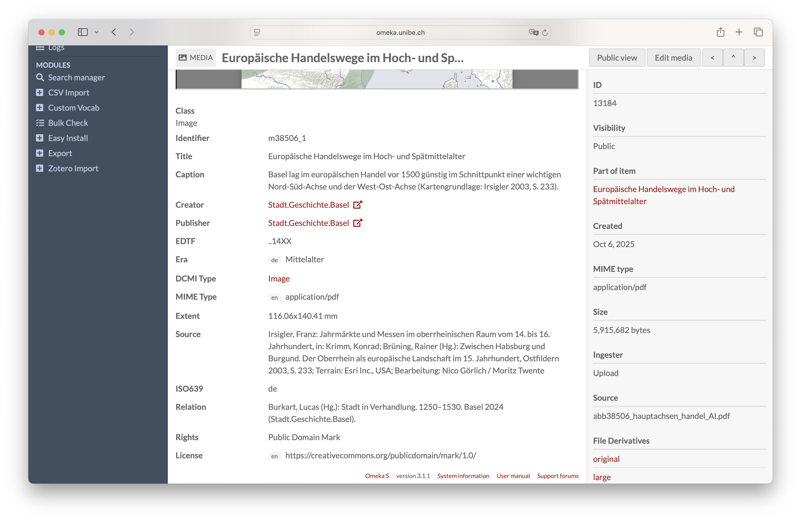

Slide 16
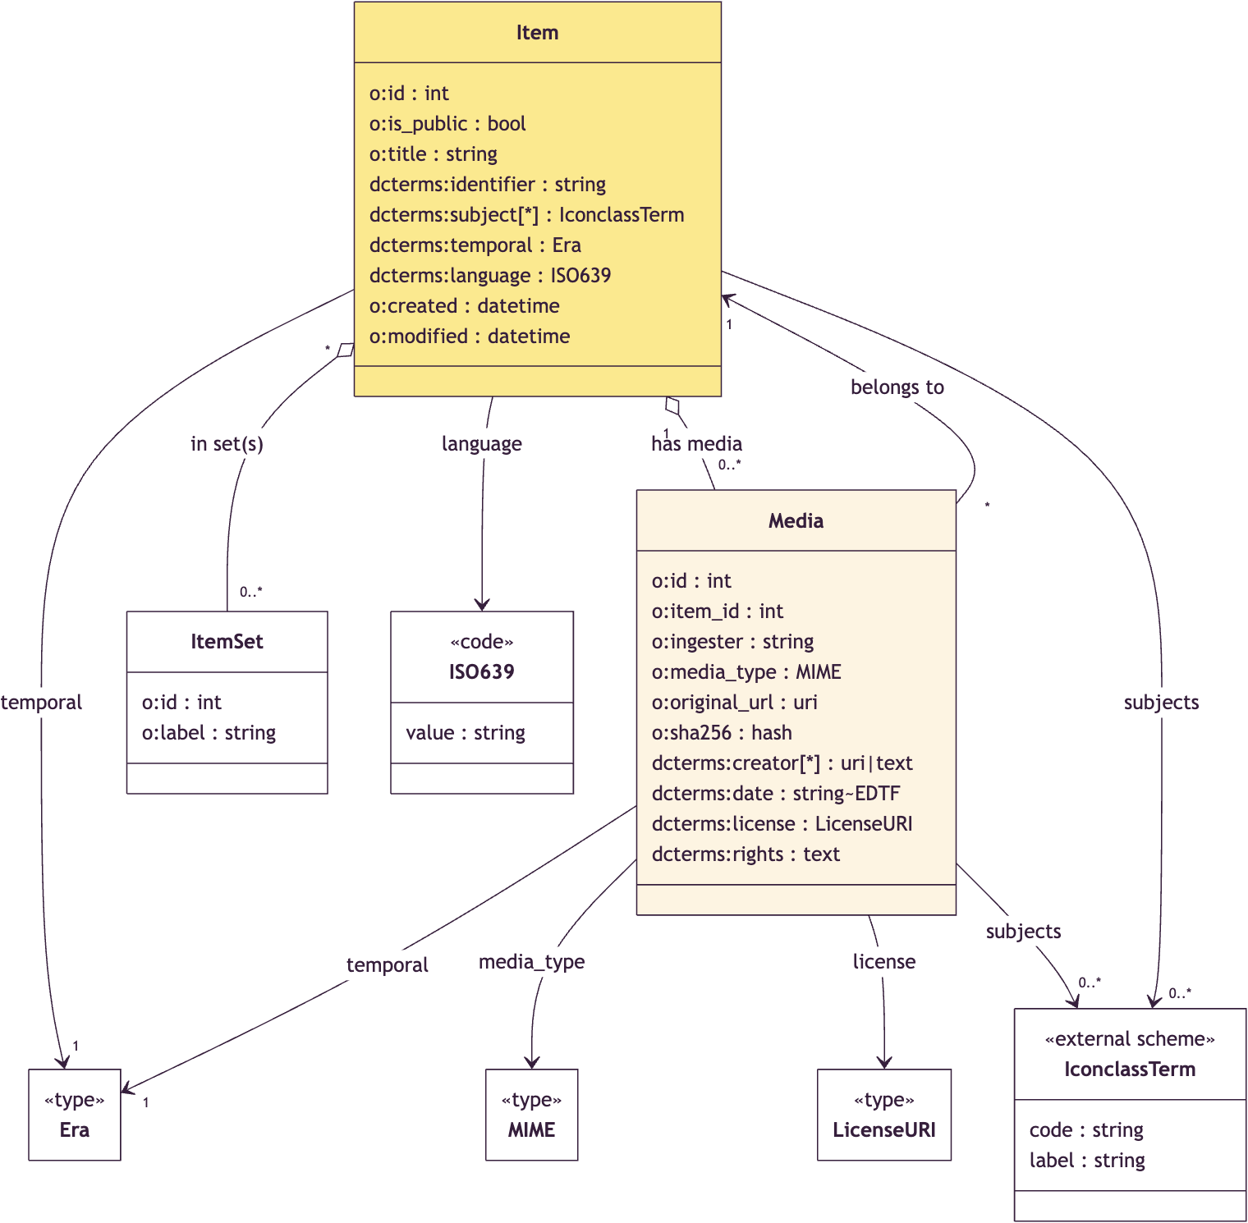
Data Model Omeka (simplified 😇)

Slide 17
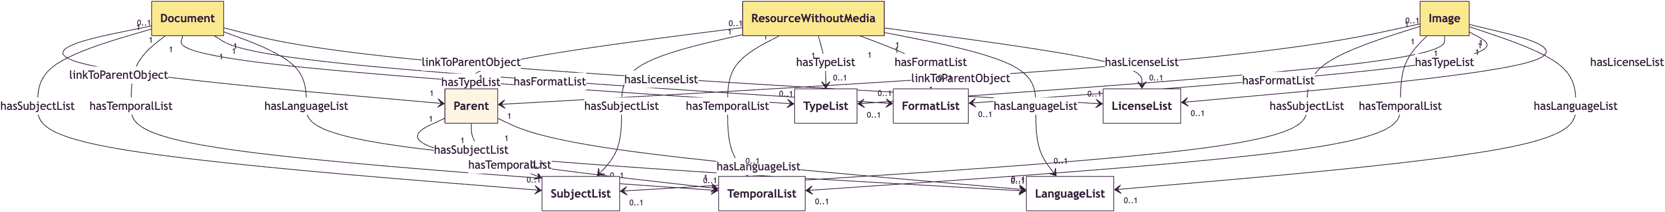
Data Model DaSCH (simplified 😅)

Slide 18
Key Differences
Modeling approach:
DaSCH: Class hierarchy (Resource → Document / Image …), explicit value classes (TextValue, ListValue).
Omeka S: Flat JSON-LD model (Item, Media, ItemSet), Dublin Core–centric.
Normalization & constraints:
DaSCH: Strict cardinalities and mandatory fields (hasTitle [1]).
Omeka S: More flexible, “validation” through templates.
Hierarchy representation:
DaSCH: Explicit Parent class and linkToParentObject.
Omeka S: Uses field ItemSet or Media to model relations.

Slide 19
Metadata Transformation

Slide 20
Data Validation
Custom Python scripts using pydantic for schema validation as Omeka does not enforce strict validation
Validation also helps identify data quality issues
Lots of manual cleaning required, all done in Omeka

Slide 21
Crosswalk Examples
Omeka Property | DaSCH Property | Notes
dcterms:title | hasTitle | Required in DaSCH (cardinality 1)
dcterms:identifier | hasIdentifier | Not by DSP used for stable references
dcterms:subject | hasSubjectList | Iconclass codes preserved
dcterms:temporal | hasTemporalList | Era mapping required
dcterms:creator | hasCreatorList | Multiple creators supported
dcterms:license | hasLicenseList | License URIs validated
Media → Item | linkToParentObject | Hierarchy explicitly modeled

Slide 22
Version Control and Updates
Challenge: DaSCH supports versioning, but requires careful planning
Strategy:
Initial deposit: Create new resources via REST API
Updates: Use PUT requests with resource IDs to create new versions
Identifier stability: ARK IDs remain constant across versions

Slide 23
API vs DSP-Tools
REST API Approach
Direct HTTP requests
Fine-grained control
Supports versioning
Complex error handling
Used for updates
DSP-Tools Approach
XML-based bulk import
Good for initial deposits
Less flexible for updates
Comprehensive validation
Used for large-scale ingestion

Slide 24
omeka2dsp

Slide 25
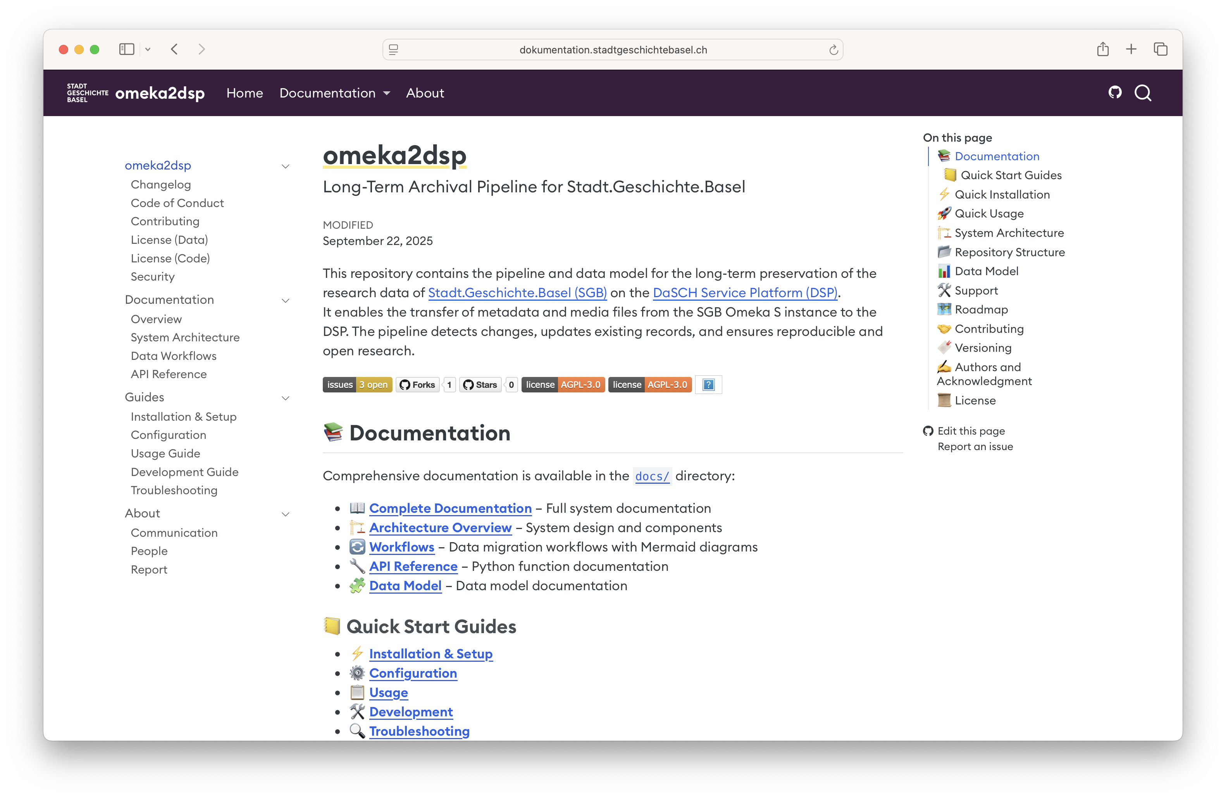

Slide 26
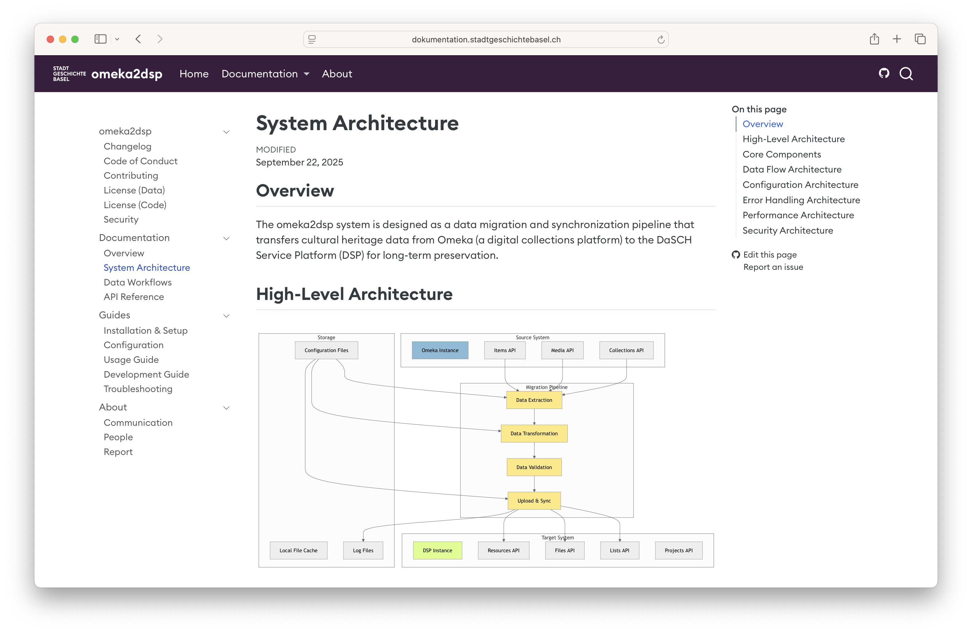

Slide 27
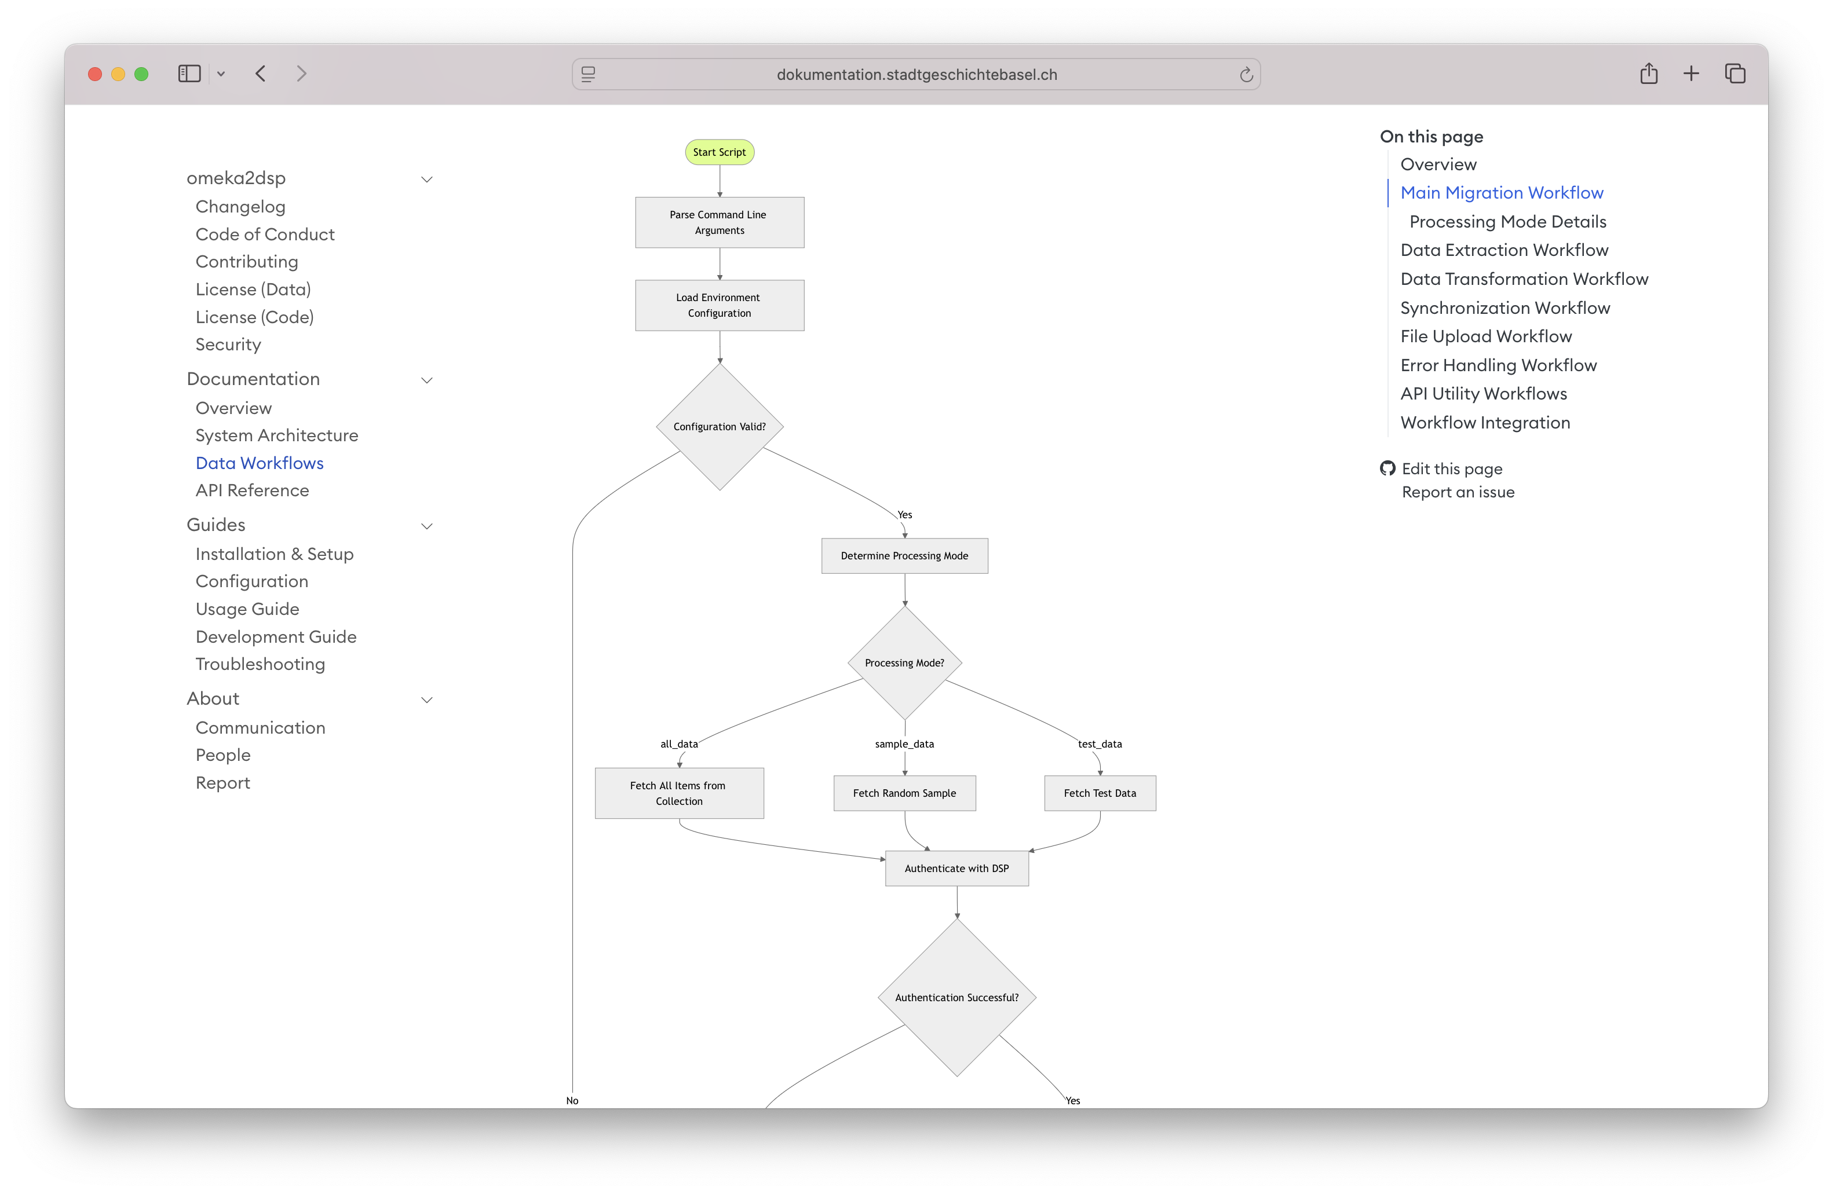

Slide 28
Lessons Learned
Metadata crosswalks and data quality: Mapping Dublin Core to the DaSCH ontology required custom logic and validation. Omeka’s flexible schema led to inconsistent metadata, demanding extensive cleaning.
Identifiers and file handling: Synchronizing identifiers between Omeka and DaSCH proved complex. Large files (>100 MB) necessitated chunked uploads and tailored handling.
Workflow timing and validation: Determining the right moment to shift from active curation to archival mode was key. Early validation with pydantic schemas and subset testing prevented costly errors.
Documentation and reproducibility: Precise mapping documentation ensured consistency across transformations and supported reproducible workflows.
Architecture and infrastructure: Decoupling archival (DaSCH) from presentation (CollectionBuilder) enhanced flexibility. Lightweight public interfaces can coexist with robust preservation systems when APIs enable automation.

Slide 29
Key Takeaways
For the Community
Lightweight publishing can work with robust infrastructure
FAIR principles are achievable in practice
Decoupled architectures provide flexibility
Open-source tools enable customization
For DaSCH Users
Plan metadata transformation early
Use validation extensively
Consider hybrid API/DSP-Tools approach
Document mapping decisions thoroughly

Slide 30
Resources
Research Data Platform
omeka2dsp Documentation
Documentation Platform

